Slide 1
Sprint 1 Presentation
Run! Quaver
Team 302
Members: Ge Bian
Xiao Kuang
Date: 11/6/2017

Slide 2

Background
Quaver!
Target:
Offer users a voice-control parkour game
Game modes:
Keyboard mode
Voice mode
Important feature: Real-time interactions between players
All players in the same global scene
Team member: Ge Bian, Xiao Kuang
Notes:
asdfoina;ioensfo;ianewfoibaoeisfn

Slide 3
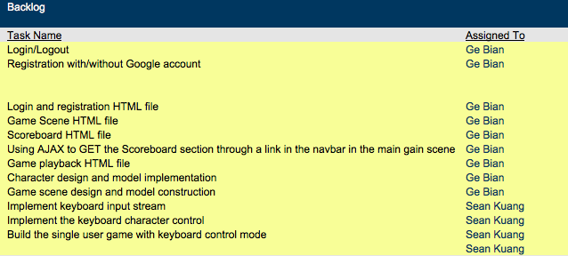

Goal & Completed Features for Sprint 1

Slide 4
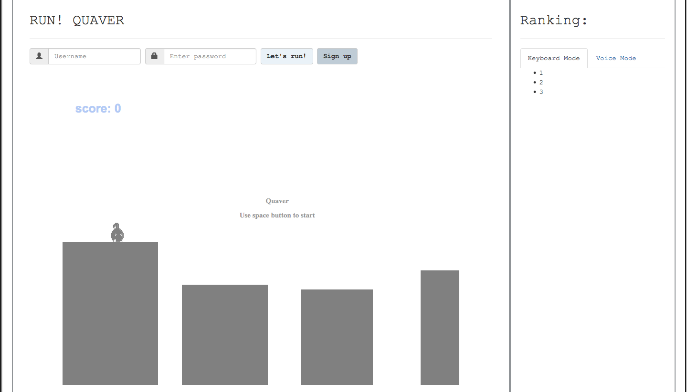
Completed features
User log in or registration
Game scene
Scoreboard/ Ranking

Slide 5
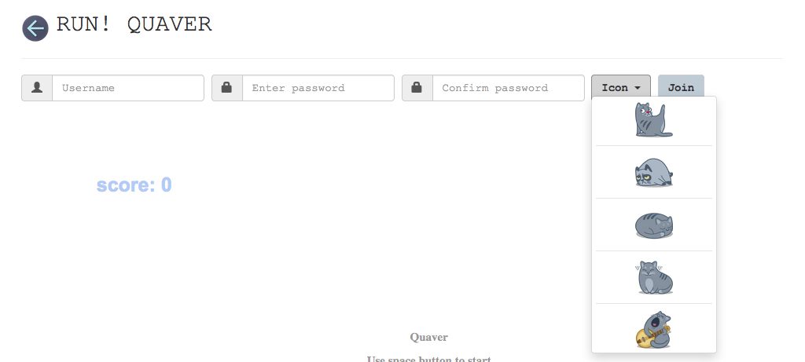
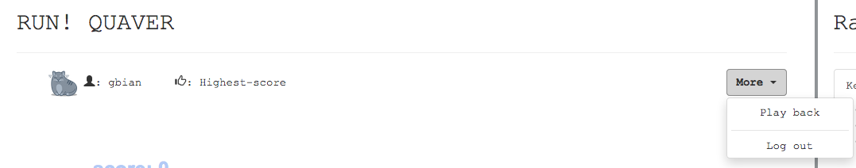
Completed features
User Registration without Google account
User info board after logging in

Slide 6
Encountered problems
lagging (created too many intervals?)
merge threads?
lazy calculation
score scheme (distance? time?)
only distance
function(distance, time)?
map generator (infinite? finite? difficulty increase?)
random generate
manual generate
more sophisticated algorithms

Slide 7
Next steps
Uncompleshed features from sprint1:
Register with Google account
Fully-working implementation for a single player with voice control mode by Sprint 2, with the voice file being stored in the database.
Voice input stream
Voice control mode
Voice storage

